Slide 1
Health Analytics Research Team (HART) Resources
Mattie Tenzer, Director
Min Wang, Ph.D., Manager
insidecarilion.org/HART

Slide 2
Our Mission
To provide consultative services to further research, QA/QI projects and grants of Carilion Clinic and our collaborative partners

Slide 3
HART
Our services:
Education
Secure Shared Drive
Epic Research Access
Biostatistical Services
Data Extracts / Data Management (REDCap)
EPIC research billing build

Slide 4
HART: Improving Client Communication/Support: New Process
Client
Submit
Client
Submit
IRB
Notify
Project
Client
Launch
R&D
Notify
Changes
Notify
Notify
Review and Recommend
e-mail
e-mail
Confirm protocol
Provide Services
Review
Changes
HA Research Team

Slide 5
Sample E-mail Post R&D
Dear ClientName
Congratulations on receiving R&D approval for your project titled “Project Title.” I would like to offer assistance with the next steps of your project.
I see that you will be using REDCap as a data collection tool. REDCap is exceptional for secure, accurate and efficient data collection, and we would welcome the opportunity to build the tool to the specifications of your project. REDCap data are easily exported for analysis or combining with other data sources. For REDCap surveys/projects, you can use the following language in your IRB protocol to describe this tool and how you will use it. You may edit this language if you wish; however the IRB is accustomed to our description, and it may help the review of your project to make as few changes as possible.
Carilion Clinic's REDCap software will be used as the central location for data collection. REDCap (research electronic data capture) provides a secure, web-based application designed to support data management and collection for research/QA/QI studies. Carilion's REDCap servers are securely housed on site in a limited access data center, and all data are stored on Carilion's firewall protected network. The Health Analytics Research Team supports the proper development of projects and surveys in REDCap, observing appropriate change control and enforcing appropriate security controls. Data collection projects are built with a study-specific data dictionary, enforcing intuitive, accurate, consistent and complete data entry. REDCap also provides a survey tool for building and managing online surveys. Health Analytics Research team restricts user access to the IRB-approved project research team utilizing the approved processes and standards of TSG. REDCap is HIPAA compliant and provides audit trails. Data can be easily exported in several formats to a secure network directory for combination with extracted data, if appropriate, and analysis with common statistical packages.
Once we have notification of IRB approval for your project, I will be back in touch to assist you with the next steps to:
Request a REDCap project to be built for your data collection needs
Request a secure shared drive directory for your project’s data
Request biostatistical support
Research Epic Access
Other services as defined – Epic Access for chart review
We in the Health Analytics Research Team look forward to supporting you with your project. If you have any questions or need any assistance with the data/analytic/security components of your IRB application, please don’t hesitate to reach out to me, Mattie Tenzer or Min Wang for assistance. We are here to help!

Slide 6
Sample E-mail Post-IRB
Dear ClientName
Congratulations on receiving R&D approval for your project titled “Project Title.” I would like to offer assistance with the next steps of your project.
My records show that the Health Analytics Research Team was going to support you by:
Requesting a secure shared drive directory for your project’s data
Requesting a REDCap Survey/Project to be built for you
Requesting the data you requested to be extracted
Request Epic access for chart review
Biostatistical support/analysis
Other services as defined
I wanted to confirm our understanding, in case there had been any further developments while you went through the IRB review process. Please reply back to this email, attaching your IRB approved protocol, and letting me know if these services are correct, or if there have been any changes. I will then enter the requests for you, so resources will be assigned. We look forward to supporting you with this project. If you have any questions or concerns, please don’t hesitate to reach out to me, Mattie Tenzer or Min Wang.

Slide 7
Medical Records Based Research: Privacy and IT Security Concerns
Protected Health Information of our patients
REDCap great place to start
Carilion Secured Shared Directory for data
Anyone with access to data must either be on the study team or a Carilion employee
Consider Epic Research access if you will do chart review
Use Carilion or your institution’s email, not private
Obtain IRB approval BEFORE working with identifiable information (consent may be required, if feasible)

Slide 8
Statistics Support
We can assist you with:
Questions about articles you read
Study design
Choosing appropriate statistical methodology
Helping to choose data sources and collection tools
Power and sample size calculation
Data cleaning, manipulation, and analysis
Interpretation of results
Helping to write method and results sections of a document

Slide 9
Data Management
Manual chart review vs. data extraction
Long: data extraction
Wide: chart review
Notes, free text: chart review
Field calculated on the fly: chart review
Data collection tool indicative of amount of work
Use MPI (master patient index, unique) instead of MRN (not unique)
PHI: if don’t need, don’t collect

Slide 10
Data Management
What data are needed to answer the question?
What data are available / not available?
What are confounding factors?
Have data instruments changed over the time period? Upgrades to the EMR?
What are exact definitions? (ex/ ICD codes)
How to define clean cohorts without bias, attrition, impacts of changing medicine?

Slide 11
Data Sources
EPIC EMR (electronic medical record)
Most common data categories:
demographics, diagnosis, procedures, labs, flowsheets, meds, social status
Most general categories:
inpatient, outpatient, OR, …
Different timeline across facilities

Slide 12
EPIC Timeline at Carilion
Ambulatory
CMC
NRV
Optime
Radiant
Started 2/2008
8/2008
4/2009
10/2010
6/2012
Cardiant
Stork
Beacon
Anesthesia
Home
Health
5/2013
5/2013
10/2014
11/2016
2/2017
Incomplete data prior to go live dates
Paper chart reviews prior dates or may not even be available.

Slide 13
REDCap
Research Electronic Data Capture
Secure, web-based application for managing and collection of research data
Origin: Vanderbilt University, 2004
>2000 institutions, >100 countries

Slide 14
REDCap at Carilion
Go-live at Carilion 3/1/2017
Open to Research, QA/QI
Installed and maintained by HART
Free of charge

Slide 15
Carilion REDCap Infrastructure
REDCap
Database Server
REDCap
Web Server
Store all data
Provide user interface
Carilion Internal Users
encrypted
encrypted
Affiliated Institutions
DMZ
Internal
Firewall
External
Firewall
Collaborator’s Computers

Slide 16
REDCap Project Types
Survey
- Forms to collect data from respondents, typically via emailed links
Traditional project
- Data entry forms for consistent data collection
Longitudinal Study
- Data gathered for the same subjects over time
Combination of the above

Slide 17
Field Types
Attachment
Text
Date
Calculated field
Phone #
Email
Choice: radio button
Choice: drop down
Hidden question: only appear if the above answer is ‘Female’

Slide 18
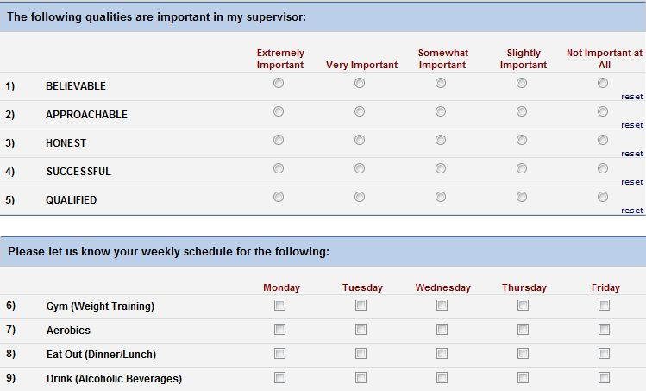
Matrix

Slide 19
Survey Distribution Methods
Email invite
Public survey link
Embed survey on website
QR code

Slide 20
Analyzing Results
Descriptive
Export to Excel, R, SAS, SPSS, Stata for further analysis

Slide 21
REDCap Data Sharing
Multiple Sites
Collective Data (de-identified)
Carilion REDCap
Carilion User
Collaborator 1
Collaborator 2
Carilion Data
Collaborator 1 Data
Collaborator 2 Data

Slide 22
REDCap Data Sharing
Define each individual user’s specific access

Slide 23
Audit Trail

Slide 24
REDCap Demonstration Project

Slide 25
Hypothetical Problem Statement
A recent study at Yale suggests that physician political persuasion impacts care provision to patients.¹
A second study unexpectedly found that provider views on self-efficacy of screening, assessing and counselling had an inverse impact on patient drinking.²
1. Hersch, ED, Goldenberg MN, “Democratic and Republican physicians provide different care on politicized health issues.”
PNAS 2016 113 (42) 11811-11816; published ahead of print October 3, 2016, doi:10.1073/pnas.1606609113
2. Elwy AR, Horton NJ, Saitz R. Physicians’ attitudes toward unhealthy alcohol use and self-efficacy for screening and counseling as predictors of their counseling and primary care patients’ drinking outcomes. Substance Abuse Treatment, Prevention, and Policy. 2013;8:17. doi:10.1186/1747-597X-8-17.

Slide 26
Hypothetical Study
This study undertakes to examine whether physician personal history and views regarding alcohol and/or tobacco influences their perception for how they address alcohol or tobacco use with patients.

Slide 27
Hypothetical Study
Primary Question:
Do provider views, history and usage on alcohol and tobacco impact how they address alcohol and tobacco use with patients?
Secondary Questions:
Do providers perceive that they intervene more often than they actually do?
Is there any correlation between the providers views, history and usage and the success of interventions with patients?

Slide 28
Hypothetical Study Design
Survey sent to primary care physicians to voluntarily complete
Research study team is blinded to responses by physicians
Data extract of responding providers’ patients – random sample
Chart review to determine
tobacco/alcohol use by patients
Interventions/counseling by provider

Slide 29
Hypothetical Study Design
Survey questions
Personal use of tobacco products and alcohol
Close family use of tobacco products and alcohol
Perception of provider comfort level addressing tobacco and alcohol use with patients
Perception of efficacy of patient intervention

Slide 30
Hypothetical Study Design
Data extract
Patient identifiers
Alcohol abuse diagnoses
Tobacco use indicators
Last visit date

Slide 31
Hypothetical Study Design
Chart Review
Review most recent visit and next most recent visit within 2 years
Determine tobacco use at each visit
Determine alcohol abuse at each visit
Determination of provider intervention and type at each visit

Slide 32
Hypothetical REDCap Project
https://redcapweb.carilionclinic.org/redcaptest/surveys/?s=DH9F8AHXEW
https://redcapweb.carilionclinic.org/redcaptest/

Slide 33
HART Drop-In Office Hours / Move
Riverside III, Conference Room IIIA
Every Friday, 8am – 12 pm
Riverside I, 1st floor, VTCSOM only
Thursdays, 1-5 pm
RMH, 1W Hot Spot
Wednesdays, 9:00am - 5:00 pm
Rehab: Move end of January/early February

