Slide 1
Avoiding the filing cabinet: Writing up your research study
Sarah Henrickson Parker, PhD
VTCRI, VTCSoM, Carilion Clinic

Slide 2
Why do you read an article?

Slide 3
What are the best articles you have read? Why?

Slide 4
When should you start thinking about your write up?

Slide 5
Where much research ends up

Slide 6
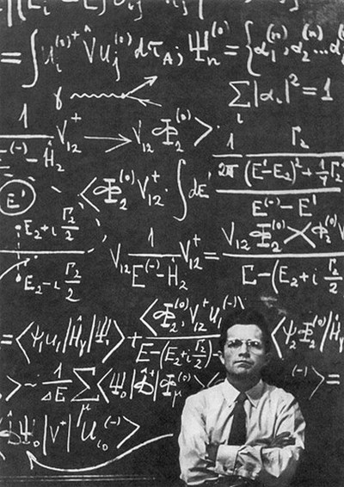
This is not scientific writing

Slide 7
Learning objectives
At the end of this session I want you to
Articulate a plan for writing up your study
Write draft 1 of your methods, possibly results or intro
Find a partner to help you (in the group or outside)

Slide 8
Agenda
Comforting thoughts
Prompts to start writing
Tactical advice for submission success
How I was taught to write an article
Submission, Acceptance, Revision, Rejection
Practical advice for creating a writing habit

Slide 9
This is hard.
You’re an expert clinician.
You’re not an expert writer (YET).
I’m not either and it’s my job.
It takes time- like, years.
It takes passion- like, a lot.
You’re not alone.

Slide 10
Academic Success Depends on Writing
Most medical writing is about trying to answer a question
This means your question has to be really clear and strong
What is the question? (write it down)
What are your data elements? (write them down)
How did/will you collect them (write them down)
10 mins

Slide 11
Well done!
You’ve just started your method section!

Slide 12
TIME.
“I will treat writing as the nuisance it often is… as something that should be done, albeit grudgingly, in brief session amidst more important daily tasks” – Boice, 1992

Slide 13
Structure of a paper
Title
Abstract
Intro
Method
Results
Discussion
References
Figs/Tables
Acknowledgements

Slide 14
Don’t feel beholden to the paper structure to write
What is the problem?
We want to recruit excellent IM fellows who are likely to finish their fellowship
What do you think is the answer?
Interview, transcripts, letters of rec, some sort of objective evaluation
Why do you think that’s the answer?
Lit review (review article)
Findings from an intervention study (data-driven paper)
Experience (editorial)
Then rearrange

Slide 15
Another prompt for unstructured writing
Write your question,
what you thought you would find,
why,
what you found,
why is that interesting (within the context of the literature)
10 mins

Slide 16
Share

Slide 17
Order of reading vs order of writing
Figures/tables
Data
Shows what’s interesting
Method
Very easy, early win (avoid delay discounting- lower value on a future reward vs immediate)
Results
Statement, limit interpretation, figs and tables
Intro/Discussion
Hard, but if you know where you want to go it’s easier
Abstract

Slide 18
Identify a target journal early
Don’t write then look for a journal
Where do you cite?
What do you read?
Impact factor?
Special calls

Slide 19
Instructions for authors
http://jama.jamanetwork.com/public/instructionsForAuthors.aspx

Slide 20
Identifying authors
This is tricky
DO IT EARLY!!!!!!!!
Author guidelines- ICMJE (international committee of medical journal editors)
First and senior

Slide 21
Importance of reading background
Need to put your work in context
Make sure no one else has done what you are proposing
Do not ever assume you are the first to think of this idea
Method ideas
Helps you figure out where to target for publication

Slide 22
Types of research germane to HC
Quantitative
Descriptive
Correlational
Quasi-experimental
Experimental
Qualitative
Understanding a social or human problem
Discovery
Mixed method
Combo Quant and Qual
Focus on triangulation
Application
Generate EBM
Test new practice
Med ed
Patient safety
Etc…

Slide 23
Format
Intro- why I did this
Method- how I did this
Results- what I found that’s meaningful
Discussion- what I think it means and implications
Revise what you wrote before, 10 mins

Slide 24
Share

Slide 25
Style
Formality
‘we’ vs ‘the authors’
Accuracy and clarity
Grammar
Standards for reporting: PRISMA, CONSORT

Slide 26
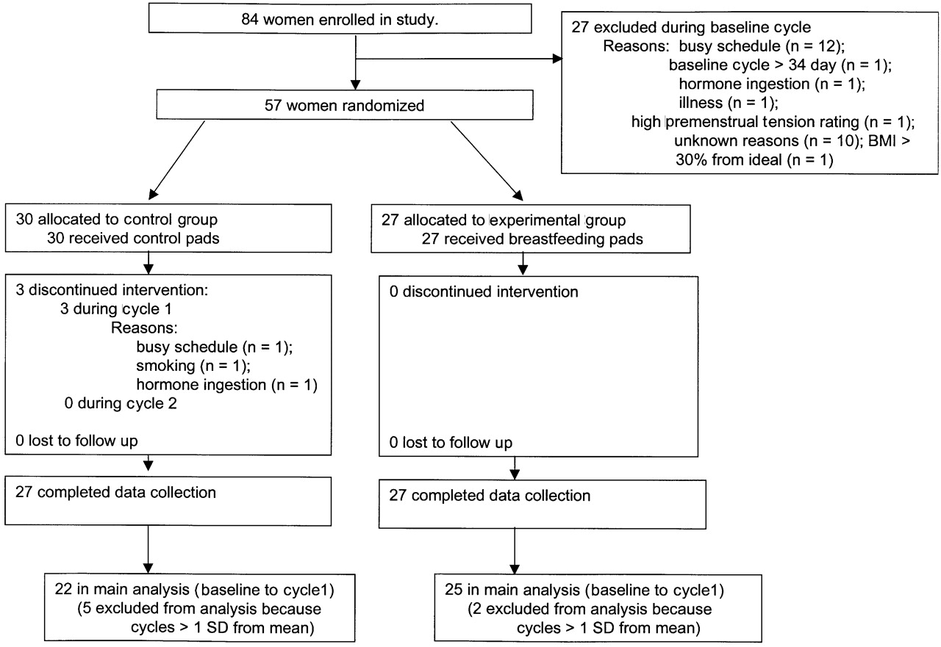
Method
Allow others to replicate
Allow others to evaluate
Level of detail can vary
Picture is worth 1K words
Subheaders?
Participants
Materials
Setting
procedure

Slide 27
Figs/tables
Tables
should be stand alone
Use same format if you can
Match text with tables, but do NOT restate table in text
Figs
Large enough font
Color
Title and description
See instructions for authors

Slide 28
What tables do you think you will have in your paper?
Make the skeletons (10 mins)

Slide 29
Results
Figs/tables
Summarize findings
Just the facts, ma’am
Emphasize the finding not the figure
Not good: table 5 shows that researchers are cooler than accountants.
Better: Our results show that researchers are cooler than accountants (fig 3).

Slide 30
Intro
What is your question
Why does it matter
Larger relevant literature
What is the gap
General vs specialist journals
Make the reader think “this question is important, and one way to answer it is x”
Then follow up with x in your method.

Slide 31
Discussion
Why do your results matter?
Where do your results fit in the context of the literature?
What did you add?
ANSWER THE QUESTION FROM THE INTRO!
What additional research is needed?

Slide 32
Discussion cont’d
Limitations
This is important and must be well thought through, shows rigor. If you don’t mention reviewers might think you think your paper is perfect. It isn’t.
Defend why you did what you did for each limitations

Slide 33
References
Show you have read and are not replicating something thinking its novel
Give others credit
Help readers find further information
Shows you can relate to other work
FORMATTING and ACCURACY
Mendeley, Endnote, others?

Slide 34
References cont’d
It’s easy to not be rigorous
Read what you cite
Sometimes authors of the work you cite will be asked to review

Slide 35
Title/Abstract
Concise
Most widely read
Whether or not to read the rest of the paper
Structured vs unstructured
What is your current title? (5 mins)

Slide 36
Share

Slide 37
The hour glass
Larger lit
Topic area
Your study
Impact on topic area, applications
Contribution to literature

Slide 38
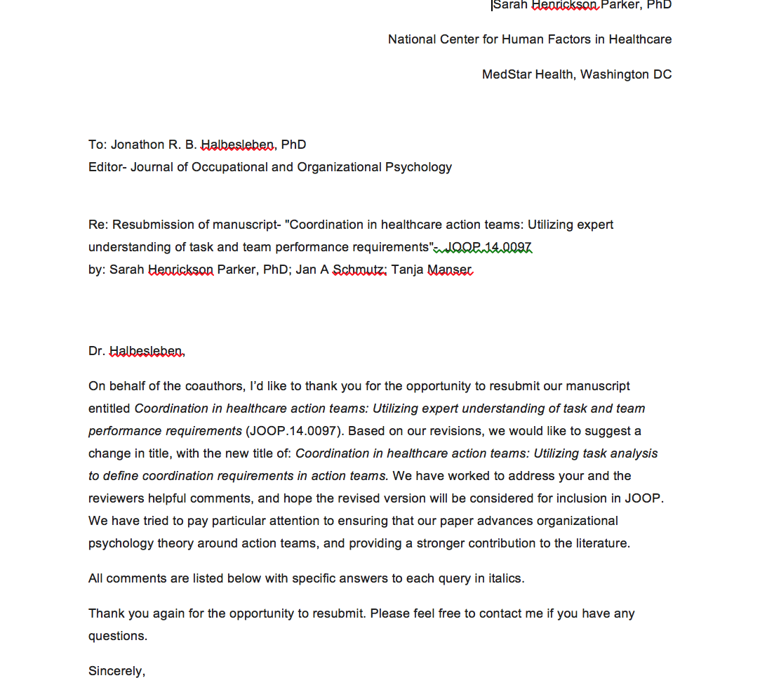
Submitting
Website
Cover letter

Slide 39
Impact Factors

Slide 40
What happens next
What it feels like
What actually happens
Desk/Technical eval
Peer review
Comments collated by editor
Editor decision
You are notified

Slide 41
Decision
Accept as is (rare)
Accept with minor revisions
Revise and Resubmit
Reconsidered by the reviewers
Reject

Slide 42
Why are papers rejected
Appropriateness of journal chosen
Research is seriously flawed
Macro aspects of writing (organization, logic flow)
Micro aspects of writing (word choice, grammar, spelling, punctuation)
Crap diagrams
Following “instructions for authors”
“sufficiently important and free from flaws to justify publication”- APA

Slide 43
Rejection
Try, try, again
Everyone, EVERYONE gets rejected
Resubmit quickly
Do NOT take it personally
Use the critiques, make it better.
Same reviewer might get it again

Slide 44
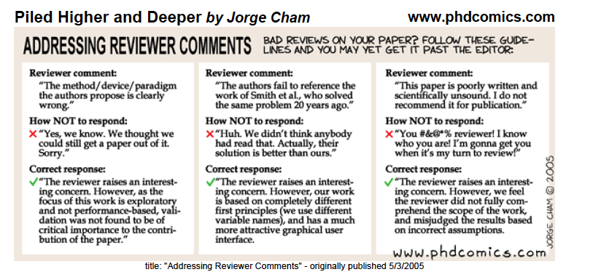
Accept with Revisions and Revise and Resubmit
Deadlines to turn around
Letter about the revisions
Instructions to authors

Slide 45
From an expert on faculty success…
Writing is critical to promotion
First 3 years, no writing
Professional writers habits
Binge writers vs intervention (daily writers)
Intervention wrote more and was more creative
Intervention: Write regularly (4x/week) 15 mins at first, 30 mins total. First thing in the morning
Boice, R. Procrastination, busyness, and binging, Behaviour, Research and Therapy.
Boice, R. Increasing the writing productivity of “blocked” academicians. Behaviour Research and Therapy. 1982; 20(3): 197-207.

Slide 46
Power of routine
Successful researchers write. A lot.
And get rejected. A lot.
Write. It doesn’t have to be good.
Routine/habit?
Enjoy the process to an extent… LOVE the result.
Ask for help

Slide 47
Nuggets of Wisdom
Simple, realistic, practical timeline
Choose your journal first
Mimic the writing and structure
http://jane.biosemantics.org/
Write somewhere not your office
Treat writing like laundry.

Slide 48
Nuggets of Wisdom 2
Pomodoros
@Twitter- writing sprints
Order?
Tables and Figs first; intro and abstract last
Use your IRB or proposal to do the intro and method first, you’ve already basically got them written
Start the article at the onset of work when you have momentum, add results as bullets as you go
Track- treat writing like a food diary

Slide 49
Nuggets of Wisdom 3
Think about the next projects
Make it social
Weekly meetings with your collaborators (guilt is really powerful)
Find a friend and partner

Slide 50
For your reference
https://www.elsevier.com/connect/8-reasons-i-rejected-your-article
http://www.icmje.org/recommendations/browse/roles-and-responsibilities/defining-the-role-of-authors-and-contributors.html

Slide 51
Avoiding the filing cabinet: Writing up your research study
Sarah Henrickson Parker, PhD
VTCRI, VTCSoM, Carilion Clinic

